Slide 1
Smart Energy Meter & Grid Monitoring System
P.B. Guruge
160191N

Slide 2
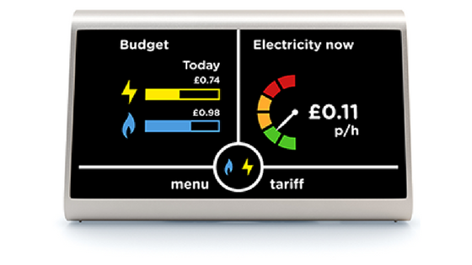
Introduction
Smart Energy Meter is a device which can be plugged to current Energy Meter to enable remote monitoring over the internet.

Slide 3
Motivation
In Sri Lanka, Smart Energy Meters introduced in 2011 only for industrial users.
Those meters have facility to measure, store and remote monitoring.
Remote monitoring only functioning in Colombo City Area.
CEB spent millions of rupees for meter readers and maintenance staff.

Slide 4
Objectives
Easy to install for existing systems.
Remote monitoring.
Lite and low cost server infrastructure.
Low design and maintenance cost.

Slide 5
Methodology
SCT-013-000 measure the current flow through the main wire and send to NodeMCU.
NodeMCU calculate the power.
NodeMCU send calculate power for 1 minute and send to server.
Server stores all the data for future use.
Web Application running on the server is the client access area to view information.

Slide 6
Special Features
No data storage on Arduino. If current supply fails, data is safe.
Very low network usage.
Get power from the meter. No need of batteries.
Can measure 0-100A.
Each part can be replaced. Simple structure and used.
Cost – Rs. 5000 (Development) Rs. 3000 (Production)

Slide 7
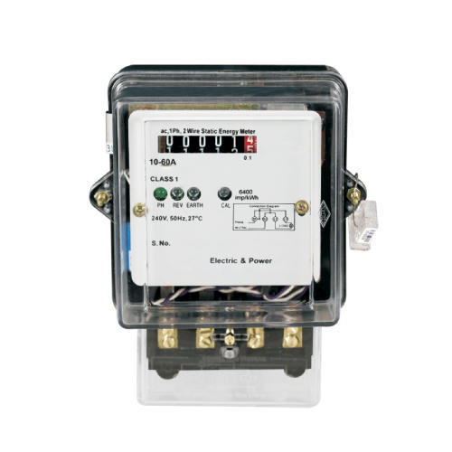
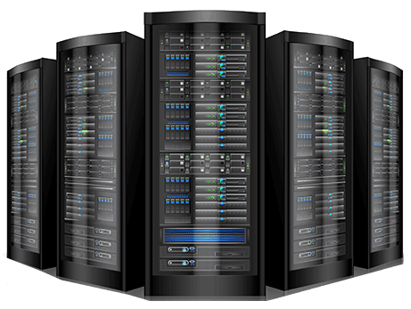

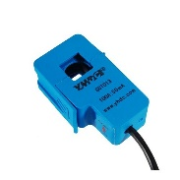
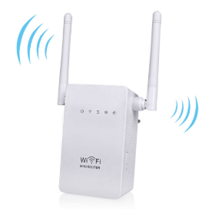
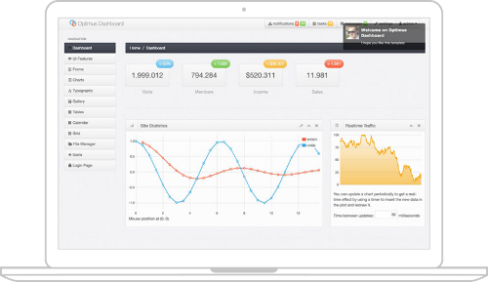
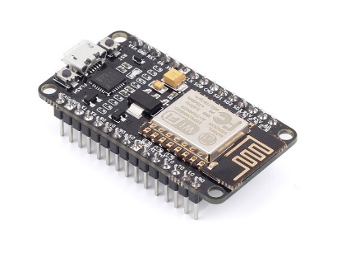
Block Diagram
Server
Internet
CT Sensor
Inbuilt Wifi Router
Node MCU
Web Application

Slide 8
Time Plan
Week | 1 | 2 | 3 | 4 | 5 | 6 | 7 | 8 | 9 | 10 | 11 | 12 | 13
Task
Study the methods & devices
1st modal testing
2nd modal testing
Build device
API & Backend development
Testing & Finalizing
Present final product

Slide 9
Thank You!

